Slide 1
D3D Review and PIX!

Slide 2
Begin at the beginning
All D3D applications will need an IDirect3D9 object.
This should be the first D3D object you create and the last you release.
The IDirect3D9 object can be used to make device queries to see what the hardware is capable of. DirectX Caps Viewer can be used to see the results.
The main thing we are going to use it for is to create the IDirect3DDevice9 object.
Notes:
-Not going to use the IDirect3D9 object for much in the render process beyond creating the device
- Show the caps viewer

Slide 3
Creating the IDirect3D9 object
IDirect3D9 *pD3D = 0;
If( 0 == ( pD3D = Direct3DCreate9(D3D_SDK_VERSION)))
cout << “Time to Panic!\n”;
D3D_SDK_VERSION is declared in the D3D headers and the function will fail if the D3D dll’s on the machine do not match the version in the header files. This should not happen.

Slide 4
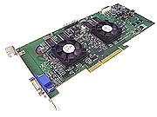

IDirect3DDevice9 Object
The device is the D3D object that will be used with most render methods.
We can think of it as representing the Graphics Card.
Notes:
Voodoo5 on the left

Slide 5
Creating the Device
D3DPRESENT_PARAMETERS d3dpp;
ZeroMemory(& d3dpp, sizeof(D3DPRESENT_PARAMETERS));
d3dpp.hDeviceWindow = hWnd; // handle to the window we want to render to
d3dpp.Windowed = true;
d3dpp.PresentationInterval= D3DPRESENT_INTERVAL_ONE;
// Remove vsync?
//d3dpp.PresentationInterval = D3DPRESENT_INTERVAL_IMMEDIATE;
d3dpp.SwapEffect= D3DSWAPEFFECT_DISCARD;
d3dpp.EnableAutoDepthStencil = true;
d3dpp.AutoDepthStencilFormat = D3DFMT_D24S8;
pD3D->CreateDevice(0, D3DDEVTYPE_HAL, d3dpp.hDeviceWindow,
D3DCREATE_HARDWARE_VERTEXPROCESSING, &d3dpp, &pDevice);
Notes:
Common values to set up the device for rendering in windowed mode with a depth/stencil buffer and vsync
Often useful to make the device and object globally available

Slide 6
The render loop
Clear Back Buffer
BeginScene
Draw
EndScene
Present
// clear the back buffer to blue
Renderer::s_pDevice->Clear(0,0, D3DCLEAR_TARGET|D3DCLEAR_ZBUFFER, D3DCOLOR_XRGB(0, 0, 255), 1, 0);
// Hey device, time to draw
Renderer::s_pDevice->BeginScene();
// Render stuff…
// Hey device, coloring time is over
Renderer::s_pDevice->EndScene();
// Hey device, show us what you’ve done
Renderer::s_pDevice->Present(0,0,0,0);
Notes:
You can tell we have cleared to blue at this point
EndScene causes all rendering to happen on the back buffer
Present causes the back buffer swap
[Filler] Having time between EndScene and Present can improve parallelism, best for rendering on a separate thread without vsync

Slide 7
“Render stuff…”
Before we can “Render stuff…” we are going to need stuff to render, duh.
Create the vertex data
Create a Vertex structure
Get an array of vertices and possibly indices
Create Geometry buffers
Copy vertices and indices to geometry buffers
Create a vertex declaration
Create the ID3DXEffect
This is the shader program

Slide 8
Create a vertex structure
D3D likes interleaved vertices.
This means we will have arrays where each element is all the data for a vertex instead of having separate arrays for each type of data like position, normals and UVs.
struct VERTEX_POSTEX
{
D3DXVECTOR3 position; // 12 bytes
D3DXVECTOR2 texcoord; // 8 bytes
};
struct VERTEX_POSNORMTEX
{
D3DXVECTOR3 position; // 12 bytes
D3DXVECTOR3 normal; // 12 bytes
D3DXVECTOR2 texcoord; // 8 bytes
};
The size of these elements will be needed when creating the Vertex Declaration
32 byte vertices run faster

Slide 9
Get an array of vertices and possibly indices
Load a model or something.
Most model formats are not interleaved so you will end up having to copy the separate arrays of data into your interleaved array
for(int i = 0; i < gdMesh.GetNumVerts(); ++i)
{
pInterVerts[i].position.x = pVerts[i * 3 + 0];
pInterVerts[i].position.y = pVerts[i * 3 + 1];
pInterVerts[i].position.z = pVerts[i * 3 + 2];
pInterVerts[i].normal.x = pNorms[i * 3 + 0];
pInterVerts[i].normal.y = pNorms[i * 3 + 1];
pInterVerts[i].normal.z = pNorms[i * 3 + 2];
pInterVerts[i].texcoord.x = pTexCoords[i * 2 + 0];
pInterVerts[i].texcoord.y = 1-pTexCoords[i * 2 + 1];
}

Slide 10
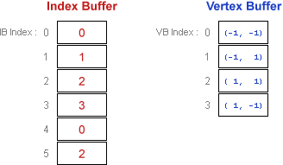
Create Geometry Buffers
IDirect3DVertexBuffer9 *m_pVertexBuff;
Renderer::s_pDevice-> CreateVertexBuffer(number of verts * sizeof(Vertex), 0, 0, D3DPOOL_DEFAULT, &m_pVertexBuff, 0);
IDirect3DIndexBuffer9 *m_pIndexBuff;
Renderer::s_pDevice->CreateIndexBuffer(number of indices * sizeof(UINT), 0, D3DFMT_INDEX32, D3DPOOL_DEFAULT, &m_pIndexBuff, 0);
Real programmers, use index arrays. They reduce memory overhead and allow for optimizations to happen on the video card.
Super programmers use one index buffer and only one vertex buffer for each unique vertex format. This will ultimately reduce how often the data streams have to be changed.

Slide 11
Copy vertices and indices to geometry buffers
void *buffer;
m_pVertexBuff->Lock(memory location in buffer we want start at,
how much of the buffer we will be messing with, &buffer, 0);
// copy vertex data to buffer
memcpy(buffer, verts, numVerts*sizeof(Vertex));
m_pVertexBuff->Unlock();
The format for the index buffer is the same.
If each mesh has it’s own buffer then the location we would start the lock at would always be 0, but that is the wimpy way.
It is better to create a class to handle copying vertex data to shared buffers that can keep track of where to copy in the buffer, and resize the buffer as needed.
Resizing the buffer will require copying all previous buffer data to a new buffer, like how the std::vector class works.

Slide 12
Create a vertex declaration
D3DVERTEXELEMENT9 decl[] =
{ {0,0,D3DDECLTYPE_FLOAT3,D3DDECLMETHOD_DEFAULT,
D3DDECLUSAGE_POSITION,0}, {0,12,D3DDECLTYPE_FLOAT3,D3DDECLMETHOD_DEFAULT,
D3DDECLUSAGE_NORMAL,0}, {0,24,D3DDECLTYPE_FLOAT2,D3DDECLMETHOD_DEFAULT,
D3DDECLUSAGE_TEXCOORD,0},
D3DDECL_END()
};
Renderer::s_pDevice->CreateVertexDeclaration(decl, &m_pVertexDecl);
The vertex declaration should be based off of your vertex structure, described back on slide 8.
The vertex declaration will be used to tell the format of the vertices going into your vertex shader methods. The usage flags, like D3DDECLUSAGE_POSITION, directly map to shader semantics, like float3 pos : POSITION0.

Slide 13
Create the ID3DXEffect
The ID3DXEffect object is the interface to your shader program.
ID3DXBuffer *errors;
#ifdef _DEBUG
D3DXCreateEffectFromFile(Renderer::s_pDevice, fileName, 0, 0, D3DXSHADER_DEBUG|D3DXSHADER_SKIPOPTIMIZATION, Renderer::s_pEffectPool, &m_pEffect, &errors);
#else
D3DXCreateEffectFromFile(Renderer::s_pDevice, fileName, 0, 0, 0, Renderer::s_pEffectPool, &m_pEffect, &errors);
#endif
The fileName can be a ascii .fx shader file or a compiled .fxo shader file.
Those debug flags will allow us to debug our shaders in PIX, which we will cover .
The effect pool will allow us to have shared variables, which can then be set once but applied to all shaders in the pool.

Slide 14

Effect Pools
ID3DXEffectPool *s_pEffectPool
D3DXCreateEffectPool(&s_pEffectPool);
Boom! You have an effect pool and now you can share parameters between shaders using the HLSL keyword shared.
Ex. shared float3 gCameraPos;
This way the gCameraPos variable will only need to be set once each frame but will be available for any shader that uses the same pool.

Slide 15
HLSL
HLSL shaders are very similar to GLSL ones except, umm… *Check if Richard Wright is looking* … better.
Creating the shader program (Effect) is far easier as we just call one function.
HLSL has texture objects in addition to texture samplers
The HLSL compiler has a preprocessor allowing us to use both #define and #include
We can use PIX to walkthrough/debug our shaders.
We can setup Visual Studio to compile our shaders and output any errors as a build step.

Slide 16
Using .fx files with visual studio
Use the NShader plugin highlighting. NShader works for most shader languages. Google it.
Go to the properties of an .fx file you have added to your project.
Change “Item Type” to Custom Build Tool. Click apply.
Add this to the Command Line option:
"$(DXSDK_DIR)Utilities\bin\x86\"fxc.exe /T fx_2_0 /Fo "%(Filename).fxo" "%(FullPath)“
Change output to $(Filename).fxo
This will cause the .fx files to be compiled when you build and will create .fxo files of the same name if succesful.
The .fxo files can be used the same way as the .fx files.
Any errors will go to your output window and clicking them will take you to the objectionable code. Which makes life easier.

Slide 17
HLSL example
// We can put common variable and function definitions in a file to be shared
#include “CommonStuff.fx”
// Our vertex shader function will output a structure like this. We have to have the POSITION0.
// This is what our fragment shader will receive as well, but without the POSITION0.
struct OutputVS
{
float4 position:POSITION0;
float4 normal:NORMAL0;
float4 texCoord:TEXCOORD0;
};
// Our vertex shader function declaration, definition on next slide
OutputVS BasicVS(float3 position:POSITION0, float3 normal:NORMAL0, float2 texCoord:TEXCOORD0)

Slide 18
HLSL example continued
OutputVS BasicVS(float3 position:POSITION0, float4 normal:NORMAL0, float4 texCoord:TEXCOORD0)
{
// You should declare all variables at the top, like you have to in C
// output structure, every member must be filled out
OutputVS outVS;
outVS.position = mul(float4(position, 1), gMVP);
outVS.normal = mul(float4(normal, 0), gWorld);
outVS.texCoord = texCoord;
// Parameters in the output structure will be linearly interpolated for each fragment.
// Where possible, it is better to put code in the vertex shader than the fragment
return outVS;
}

Slide 19
HLSL example even more continued
float4 BasicPS(OutputVS inVert):COLOR0
{
float4 color;
float nDotL;
// Get the texture color
color = tex2D(someTextureSampler, inVert.texCoords);
// Get the lighting contribution
// Since the normal is interpolated from the vertex, it will need to be //normalized
nDotL = dot(-gLightDirection, normalize(inVert.normal));
return color * nDotL;
}

Slide 20
HLSL example, finally done
technique Basic
{
pass P0
{
vertexShader = compile vs_2_0 BasicVS();
pixelShader = compile ps_2_0 BasicPS();
CullMode = CCW;
// You can set all sorts of things here
//AlphaBlendEnable = TRUE;
//BlendOp = ADD;
//DestBlend = ONE;
//SrcBlend = ONE;
//ZWriteEnable = FALSE;
//ZEnable = FALSE;
//StencilEnable = TRUE;
//StencilFunc = NOTEQUAL;
}
}

Slide 21
So how do we render?
// Tell D3D where the verts are
Renderer::s_pDevice->SetStreamSource(0, the vertex buffer to be used, 0, sizeof(VERTEX));
// Tell D3D what kind of verts we are working with
Renderer::s_pDevice->SetVertexDeclaration( the vertex declaration );
// Tell D3D where the indices are
Renderer::s_pDevice->SetIndices( the index buffer);
// Set an shader parameters needed, like the mvp matrix or whatever else
D3DXVECTOR4 pos(Camera::GetInstance()->GetWorld().WAxis.v, 1);
Effect->SetVector(context.m_hCamPos, &pos);
Continued…

Slide 22
Are we rendering yet?
// Start the effect
UINT passes;
pEffect->Begin(&passes, 0);
// Iterate through the passes
for(UINT i = 0; i < passes; ++i)
{
pEffect->BeginPass(i);
// Draw something
Renderer::s_pDevice->DrawIndexedPrimitive(primitive type, Where the first vert is, 0, number of verts, where the first index is, How many pimitives to draw);
// Finish
pEffect->EndPass();
}
pEffect->End();

Slide 23
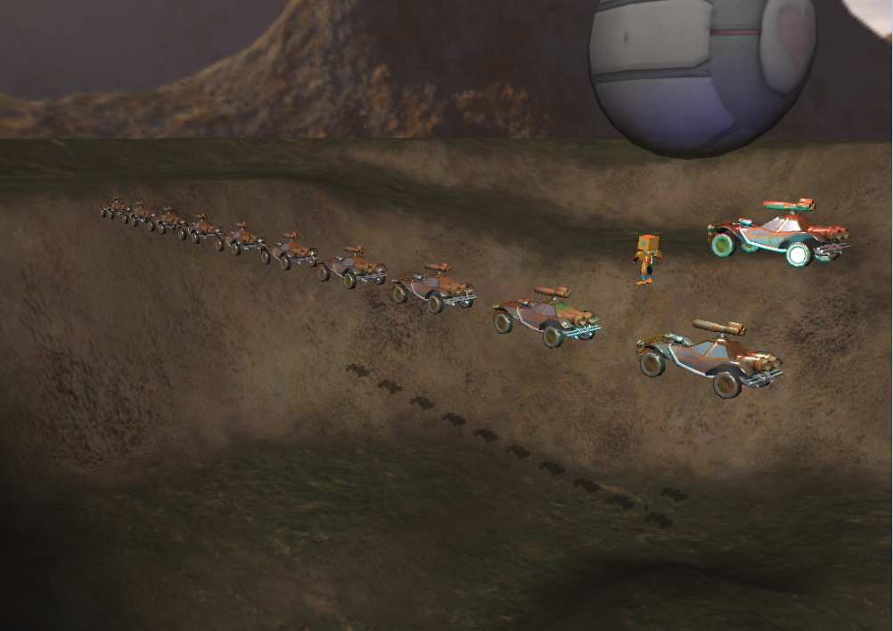
Now we are rendering and everything is perfect.
Well, if everything is not perfect we can use PIX to see why.
“PIX is a debugging and analysis tool that captures detailed information from a Direct3D application as it executes. PIX can be configured to gather data, such as the list of Direct3D APIs called, timing information, mesh vertices before and after transformations, screenshots, and select statistics. PIX can also be used for debugging vertex and pixel shaders, including setting breakpoints and stepping through shader code. “
Everyone has PIX, it comes with the DX SDK.
Let’s try it out.

